Slide 1
NEGOTIATION AND CONFLICT MANAGEMENT Preparation (what to do before a negotiation)

Slide 2
Preparation
Preparation is essential to successful negotiation
Crucially, negotiators must move beyond the “fixed-pie” perception to realize the potential for a mixed-motive negotiation involving collaboration
Consider the value of the total relationship
There are three components to successful preparation
Self-assessment
Assessment of the other party
Assessment of the situation
All three components help you develop strategy

Slide 3
Self-assessment – What do I want?
What do I want?
What is your ideal outcome or target?
Don’t aim too low or too high
Work within the context
What are the industry and relationship norms that must be considered when planning?

Slide 4
Self-assessment – What are the issues?
There are many issues to consider when determining what you want
Consider every possible issue (not just the price)
How can issues be divided into sub-issues?
Payment to supplier (when vs. how much?)
Compensation (salary, bonus, flex work, moving expenses, etc.)
How important is each issue to you?
Rank the issues (try to make subjective issues objective)
What issues are musts (non-negotiable)
Plan how you will present and address these
Determine possible settlement points on the individual issues
Understand industry and contextual norms
How might settlement points on the individual issues be negotiated in exchange for settlement points on other issues?

Slide 5

Self-assessment – What are my alternatives?
What are my alternatives?
They should be determined and ranked prior to entering a negotiation
BATNA
Best Alternative To a Negotiated Agreement
Try to make your BATNA objective (quantify it)
It should be known and acknowledged at all times

Slide 6
Self-assessment – What are my alternatives?
Your BATNA may be time sensitive and change due to contextual changes, and it may improve or worsen as the situation changes.
If possible, seek alternatives which give you more power in the negotiation
The better your BATNA, the more you can demand
Do not forget your BATNA, and do not accept an offer worse that your BATNA

Slide 7
Self-assessment – Setting a Resistance Point
Your resistance (reservation) point is the worst agreement you are willing to accept before ending negotiations and resorting to your BATNA
In most cases, should be set slightly better than your BATNA*
Better = Higher or lower “numbers,” depending on your position
The more precise the better
*Consider all issues simultaneously
Risk costs
Switching costs
Without a set resistance point negotiators often make two mistakes
Accept inferior offers or reject superior offers

Slide 8
Self-assessment – Resistance Point Example
Buyer resistance point for the Sugar Bowl
Current value is $4,000-$5,000 (consignment shop) or $6,000 (auction)
Sugar bowl individually valued at $400-$1200
Complete set at auction is $8,000-$8500
Complete set valued at $10,000-$12,000
$3,000 in checking account
Resistance point at $1200, $2500, $3000? Less? More?
Depends on many factors (e.g., risk propensity, ego, time, etc.)

Slide 9
Preparation – The other side
Who are you negotiating with?
Try to learn as much as possible about the other party
Experience, position, personal connections
Multiple people
Do they agree? Does one of them have more authority?
Who do you need to connect with and persuade?
Are there more than two parties?
Entrance, exit, coalition
Know your power and position within the various scenarios
What do you have to offer that others don’t?
Who do you need to work with/ get on your side

Slide 10
Preparation – The other side
How important are the issues to the other side?
Consider the issues you came up from their perspective
Payment to supplier (when vs. how much?)
Compensation (salary, bonus, flex work, moving expenses, etc.)
What do they need? What can you show them they need?
What tradeoffs in issue rankings might exist?
Test assumptions and adjust throughout the negotiation
Ask lots of questions and listen
Are there any issues that are inflexible for the other party?
What is the other side’s BATNA? Resistance point?
How many other alternatives do they have?

Slide 11
Combining Your Side with the Other Side
You should already know your resistance point. Once you have approximated the other party’s resistance point, you can formulate the bargaining zone
The bargaining zone is the range between the two parties’ resistance points
It is comprised of all the mutually acceptable agreements
Even though you are considering what the other party wants, remember to focus on your target (don’t forget what you want!)
How does it fit with your knowledge of the other party?
You want your target to be aggressive and close to the other party’s resistance point

Slide 12
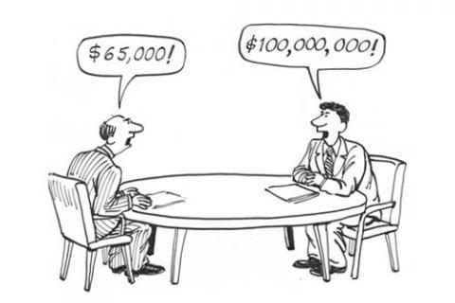
Sugar Bowl Bargaining Zone (ZOPA)
Buyer’s resistance/reservation point
Buyer’s bargaining range
$1500
$2500
$0
Positive bargaining zone
Positive bargaining zone
$3000
$350
Seller’s bargaining range
Seller’s resistance/reservation point

Slide 13
Preparation – The situation
The situation can greatly affect a negotiation
What strategies are appropriate to employ? How will information be presented?
What is the relationship?
One-shot, multiple future agreements, existing?
Is there a history? Is it expected to continue?
Reputation for using certain tactics or styles?
Trust in the individual or organization?

Slide 14
Preparation – The situation
Are there time constraints/deadlines?
Does a party’s BATNA expire?
Are there time sensitivities?
Are you their last resort?
If one party needs the deal done quickly, then they are likely at a disadvantage
Are there sensitive topics you should avoid? For both sides?
Cultural taboos, details that can’t be discussed legally, etc.
Avoid errors that could end the negotiation prematurely

Slide 15

Preparation
Time and effort spent prior to a negotiation is strongly related with positive negotiation performance
Allocate time to the three components of preparation
Self-assessment
Assessment of the other party
Assessment of the situation

Slide 16
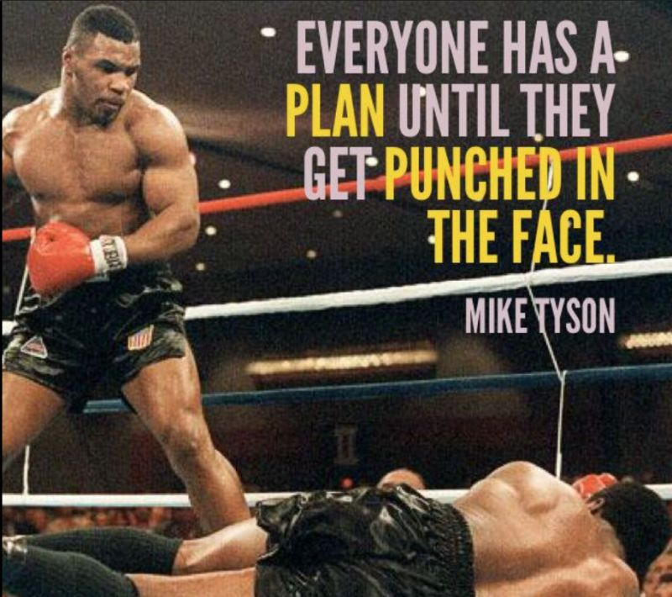
Preparation
Aim to control the conversation
Direct what is introduced and when
Plan and adjust as necessary
Use information from the other party as they provide it

